Slide 1
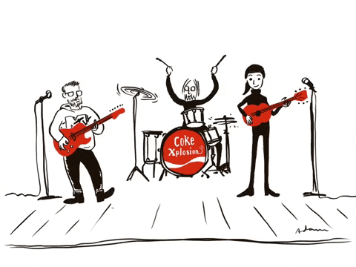
Stereo Source Separation
Reconstructing vocals & accompaniment signals
By Tom Sabag

Slide 2
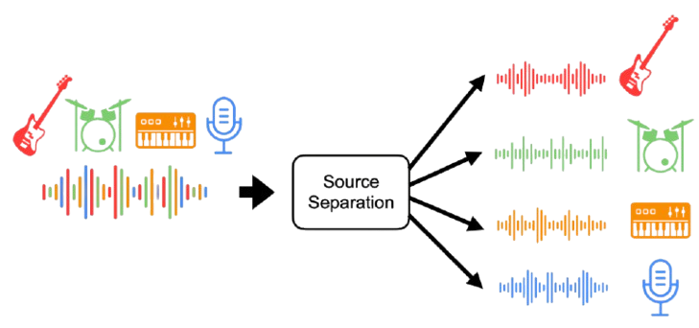
Music Source Separation
Music source separation is the task of decomposing music into its constitutive components, e. g., yielding separated stems for the vocals, bass, and drums.
Challenges: Overlapping frequencies, background noise, and phase differences.
Applications: Music remixing, karaoke, speech denoising and enhancement,

Slide 3
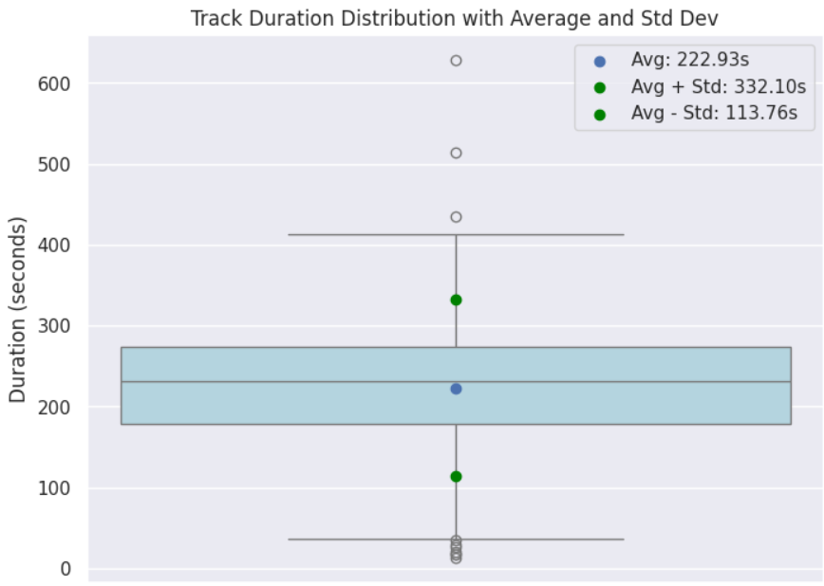
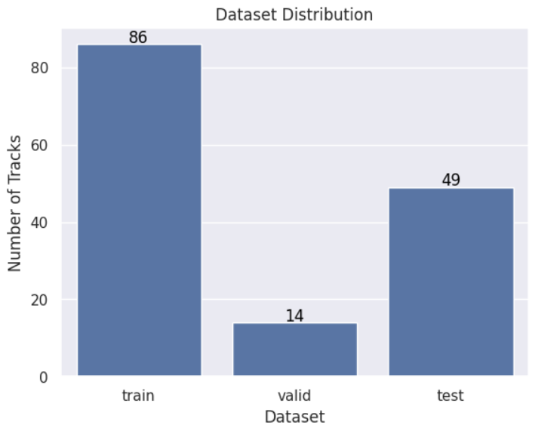
Dataset – MUSDB18
A widely popular large-scale dataset for music source separation, containing multitrack audio
Content: 150 full-length music tracks across various genres.
Sources: Vocals, drums, bass, and accompaniment
Format: Stereo tracks with separated source stems (individual instrument and vocal tracks).

Slide 4
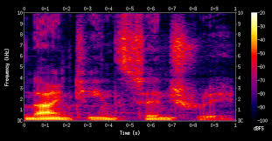
Data Representation
Stereo to Mono Conversion:
Average both stereo channels into a single mono signal
Mono Signal To Spectrogram
Apply STFT to convert signal to time-frequency domain
Convert STFT magnitude to log scale to better represent non-linear nature of human hearing

Slide 5
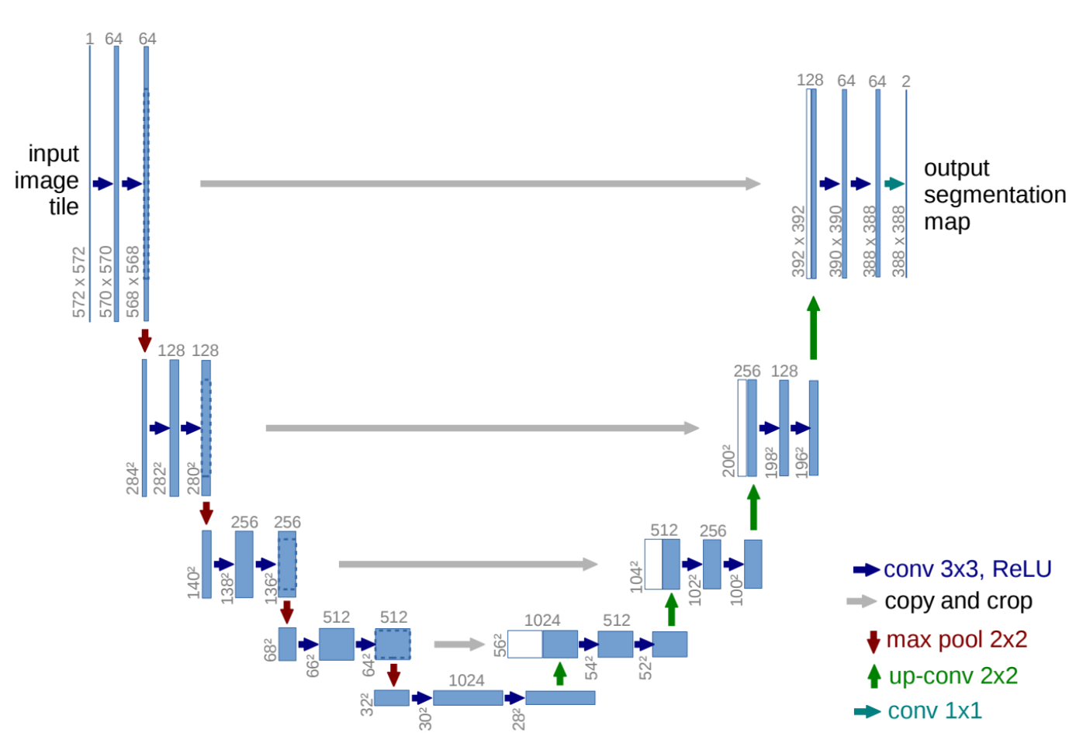
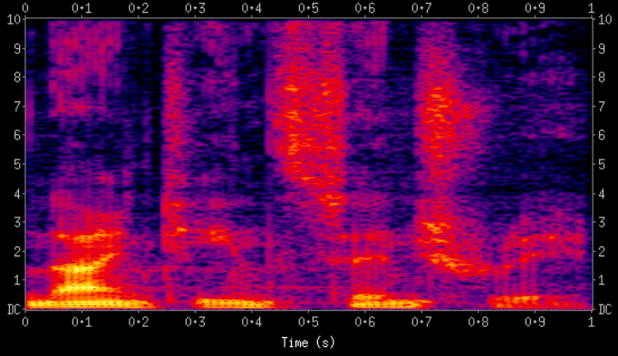
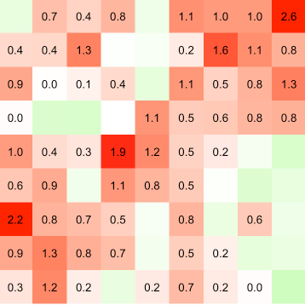
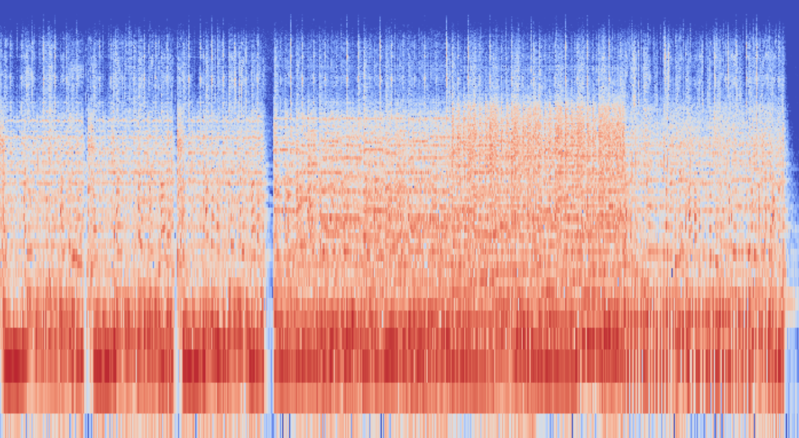
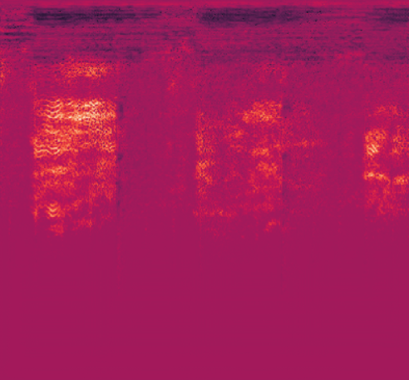
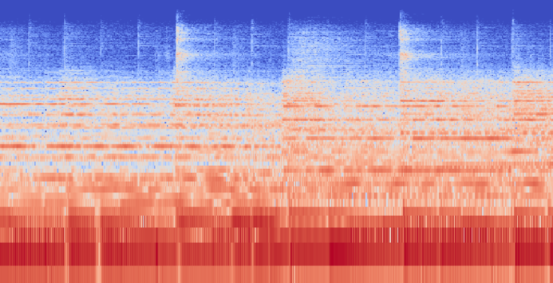
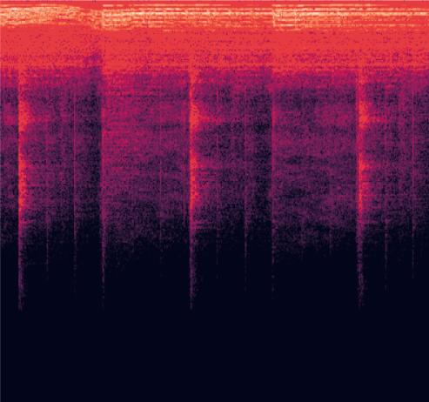
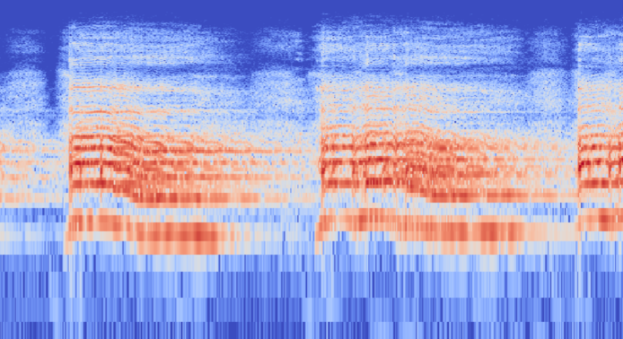
Architecture & Loss
Model: Multi-channel UNet
L1 Loss (Indirect) : MAE between original spectrogram and masked spectrogram
Mixed Spectrogram
Vocal & Accompaniment Masks
L1(
,
)
Mixed Spectrograms
Masks
Vocal, Accompaniment Spectrograms

Slide 6
UNet Architecture
Encoder: 4 Conv blocks ( 8 layers)
Bottleneck: 1 Conv layer
Decoder: Inverse of encoder with skip connections
513x516
256x258
128x129
64
128
64x64
256
1

Slide 7
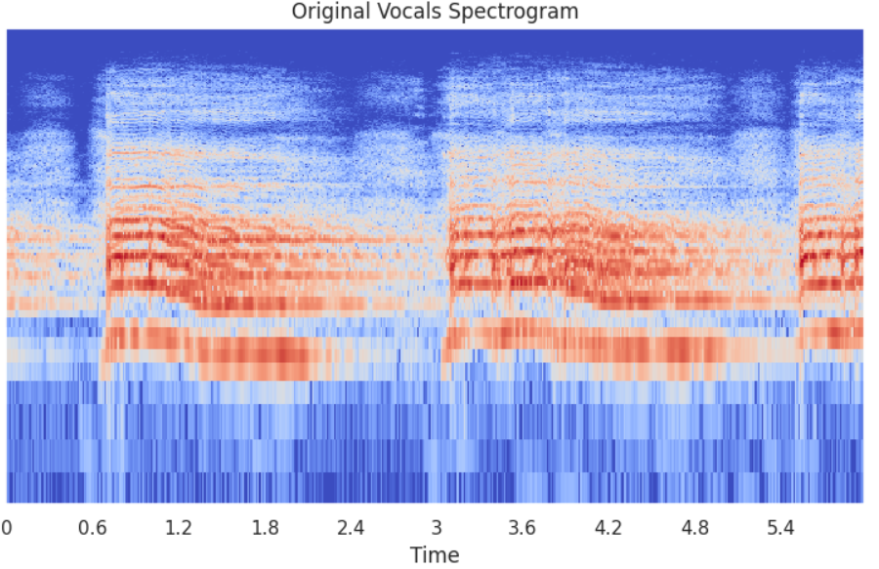
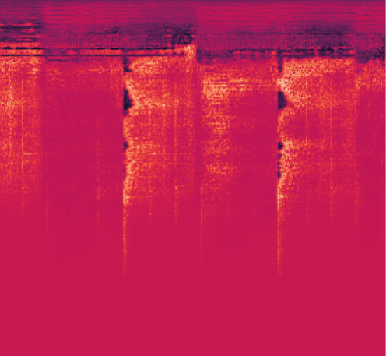
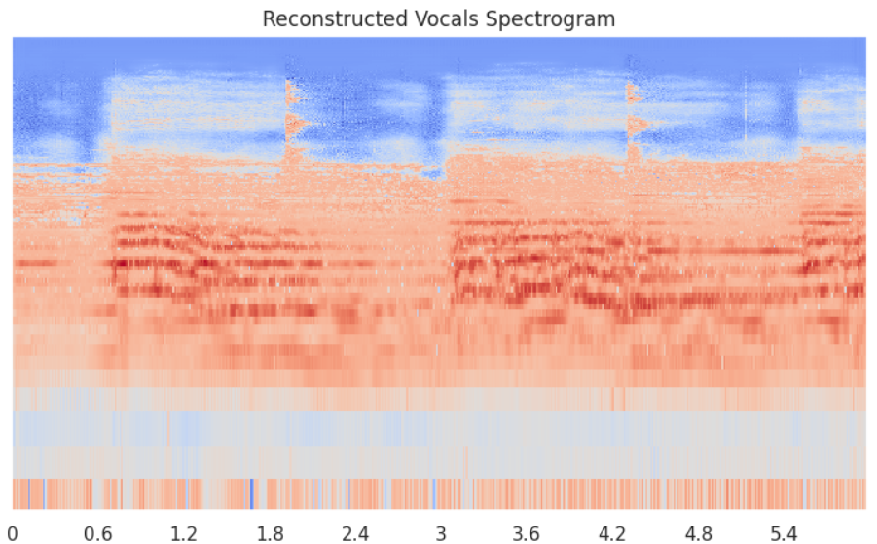
Inference – Vocals Reconstruction
Vocals Mask

Slide 8
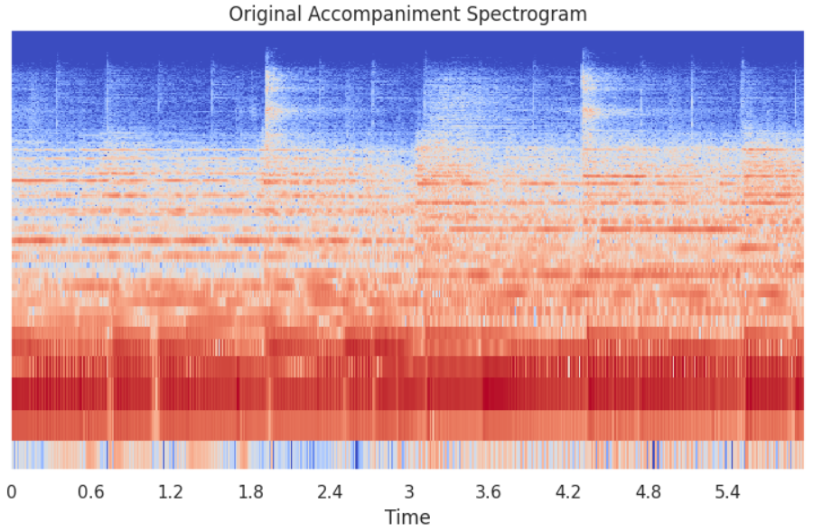
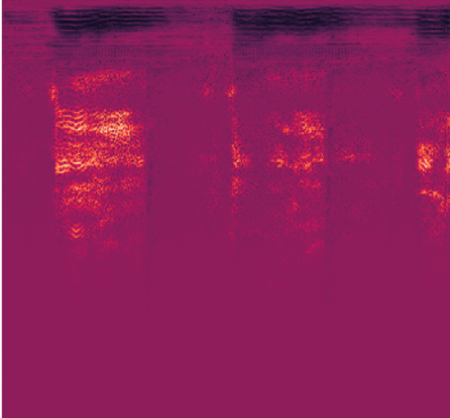
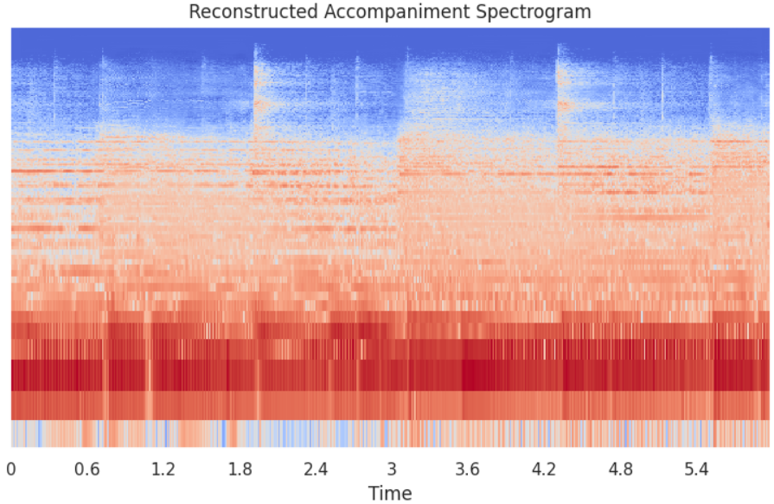
Inference – Accompaniment Reconstruction
Accompaniment Mask

Slide 9
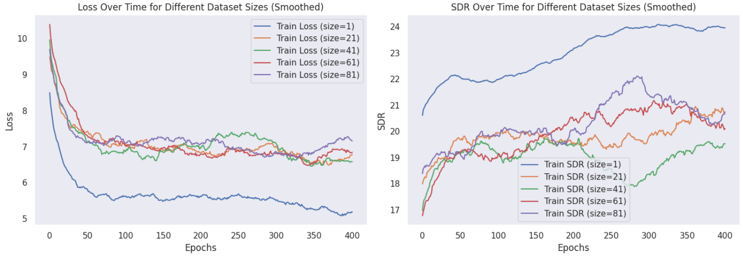
Hyperparameter Tuning – Dataset Size
Fitting the entire dataset was extremely difficult and yielded no results.
As suggested by you, I tried overfitting a smaller dataset
To decide dataset size, I tracked L1 loss and SDR metric

Slide 10
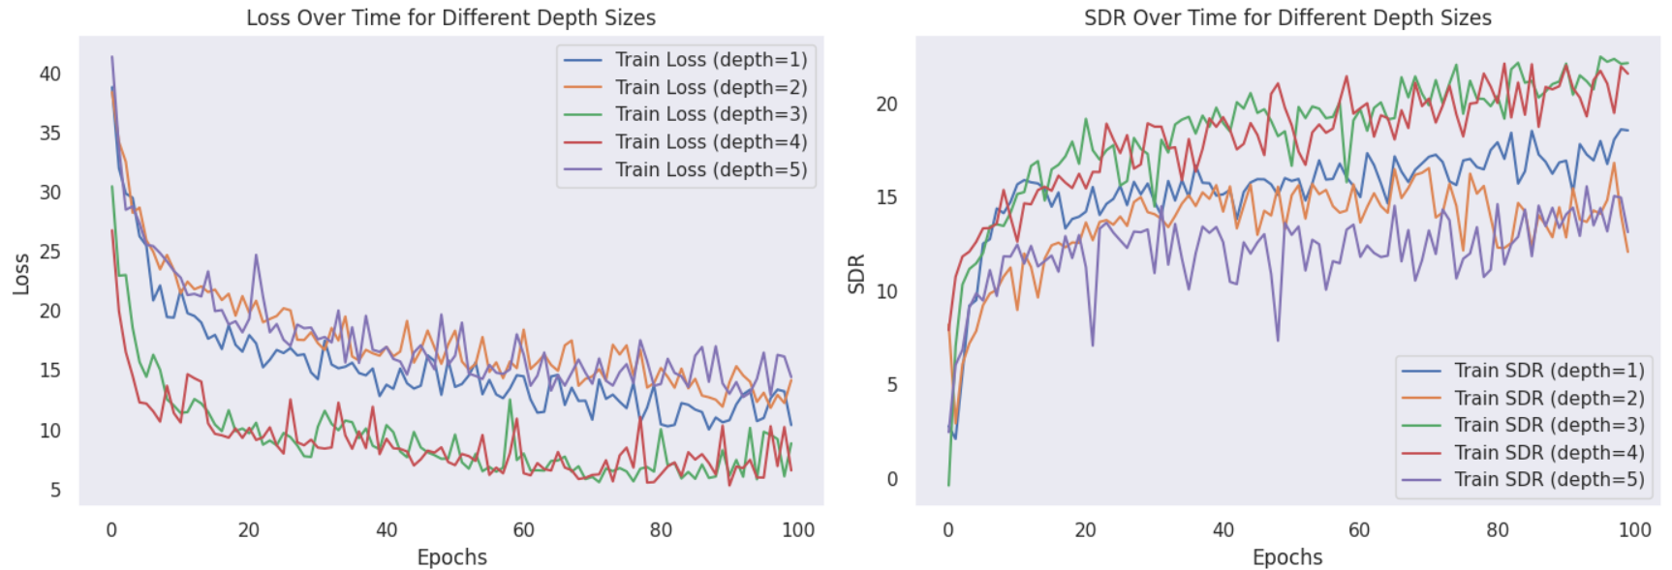
Hyperparameter Tuning – Network Depth
Encoder and decoder have the depth and parameters
Below or above a certain depth – degraded performance
Best performance for 6 or 8 convolutional layers

Slide 11
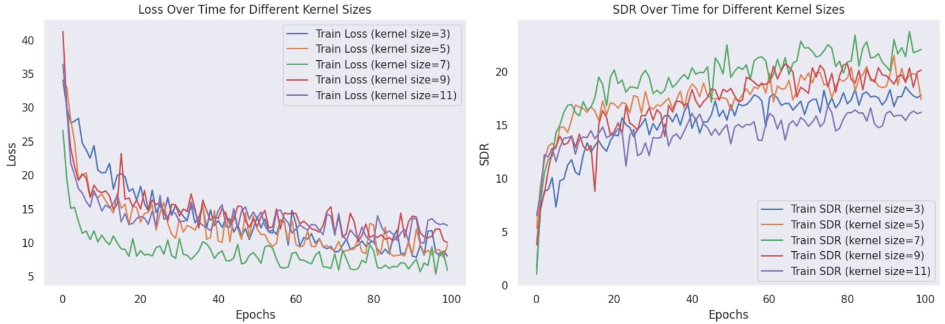
Hyperparameter Tuning – Kernel Size
The larger the kernel size, the greater the receptive field
However, more trainable parameters, difficult to optimize
A very small or large kernel sizes reduce performance
Optimal performance for kernel size = 7

Slide 12
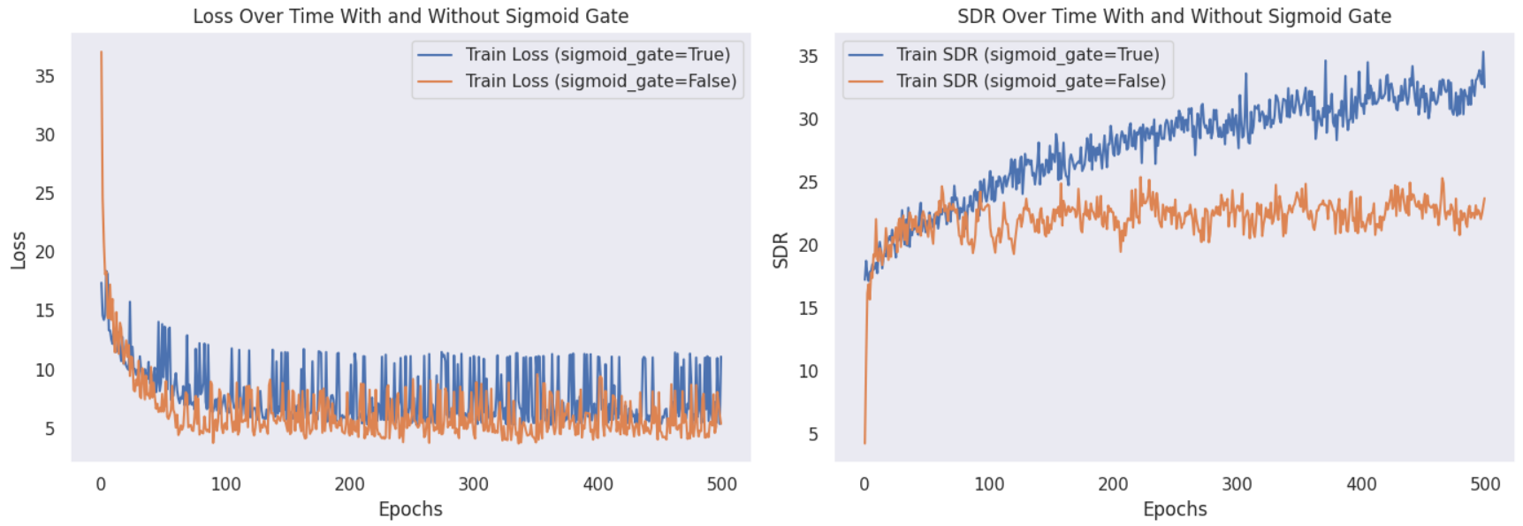
Hyperparameter Tuning – Sigmoid Gate
Similar losses over time
Surprisingly, the loss with a sigmoid gate is significantly less stable
SDR without a sigmoid gate converges, while with sigmoid gate continues to increase

Slide 13
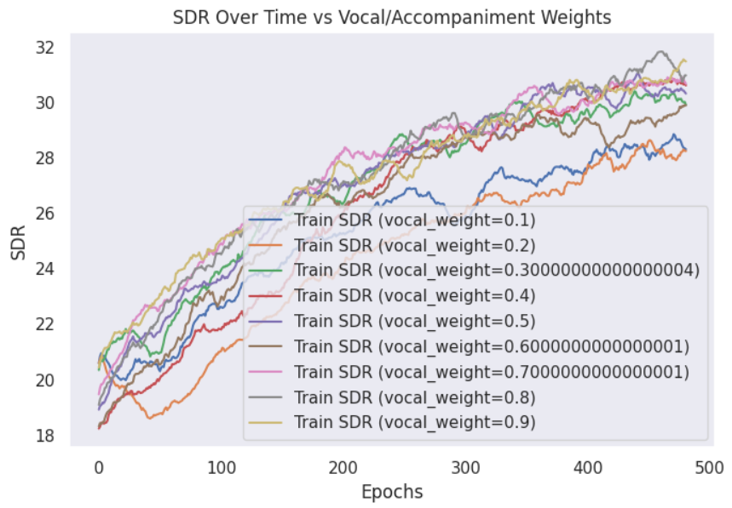
Hyperparameter Tuning – Vocals Weighting
Loss definition: θ ⋅ vocals + (1-θ)⋅ accompaniment
Smaller vocal weights result in lower SDR (0.1, 0.2)
No significant change otherwise

Slide 14
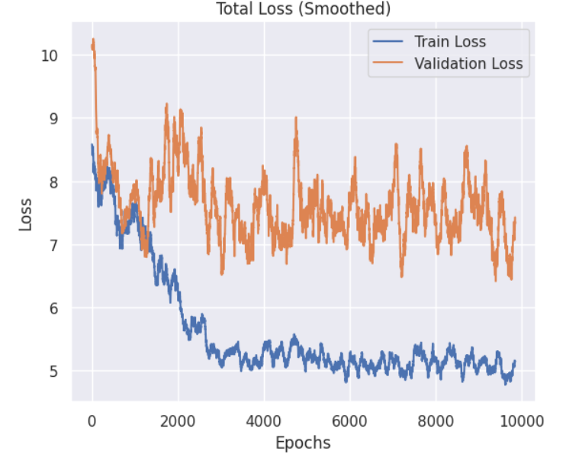
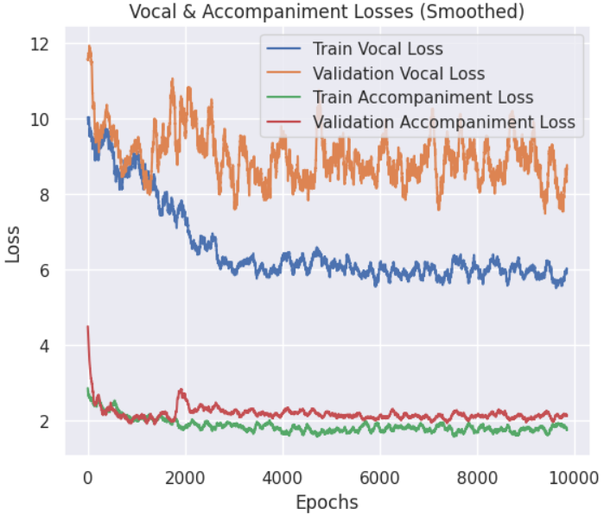
Training – L1 Loss

Slide 15
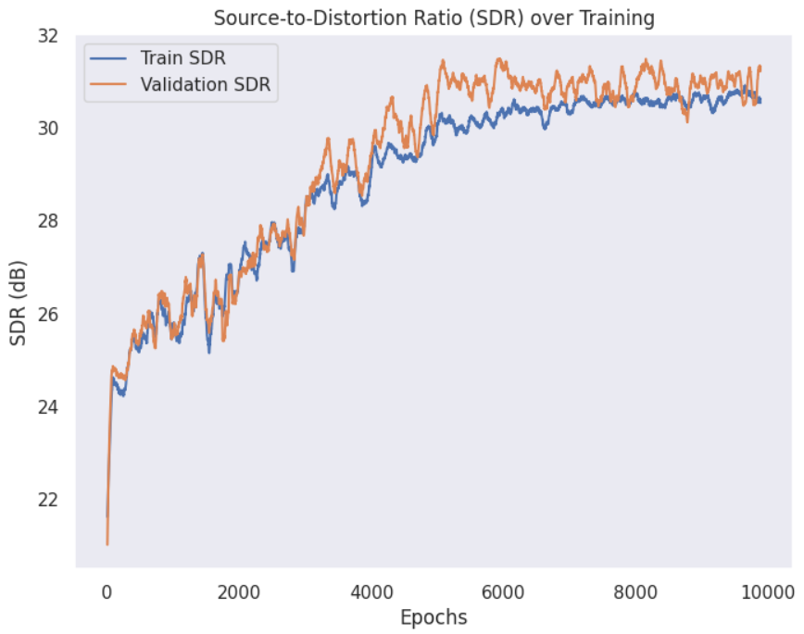
Training – SDR

Slide 16
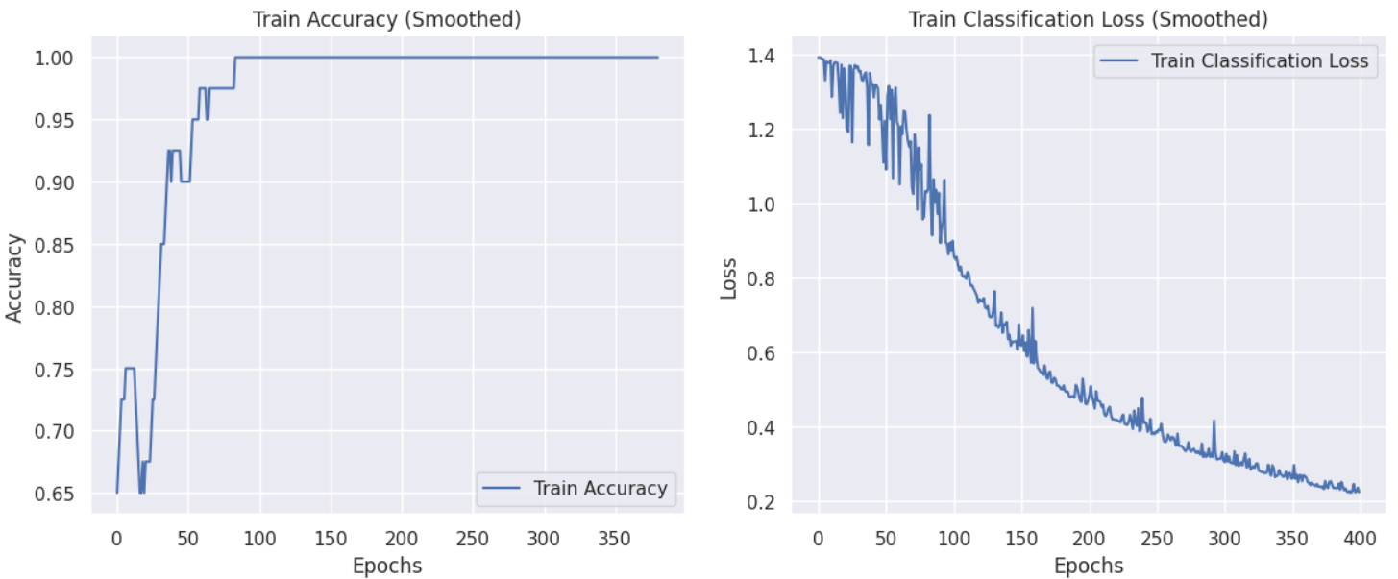
Source Classification – Sanity Check
The model initially had a poor performance.
Sanity Check: To confirm the model’s capacity to learn meaningful representations, a classification branch was added
Architecture: Added a linear layer on top of the encoder
Loss: Binary Cross Entropy

Slide 17

Separated Sources Examples
Original
Vocals
Accompaniment

Slide 18
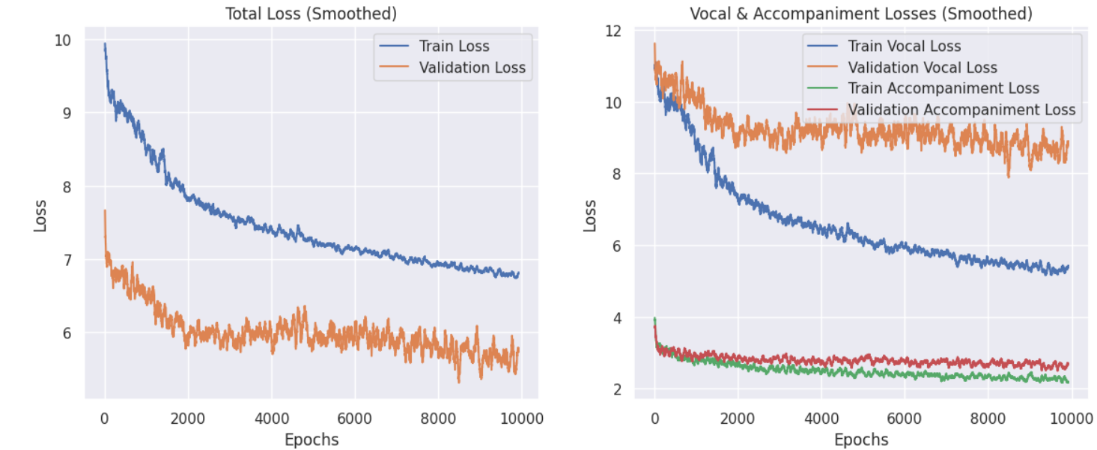
Training – L1 Loss ( 5 songs)

Slide 19
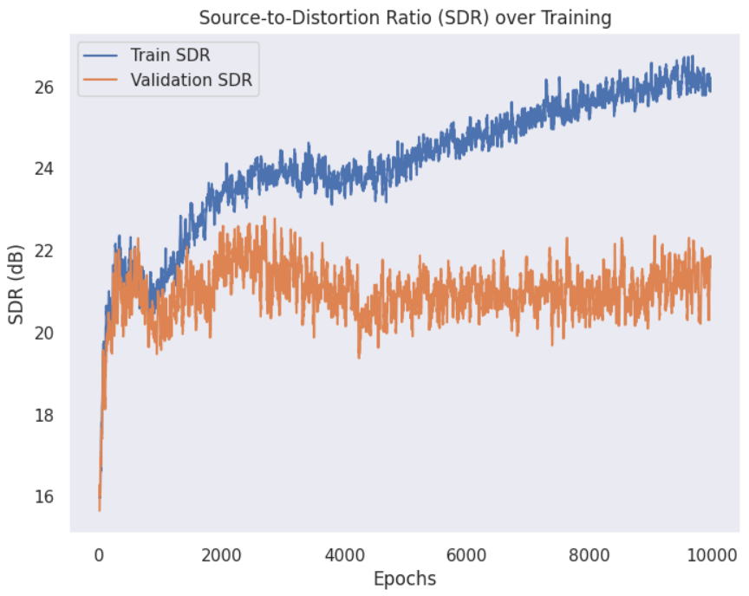
Training – SDR ( 5 songs)

Slide 20
Separated Sources Examples
Results are not too promising…
Vocals: Accompaniment is masked mostly, but vocals are quitey noisy
Accompaniment: Vocals are still present, but mumbled, accompaniment quality is okayish
Original
Vocals
Accompaniment

Slide 21
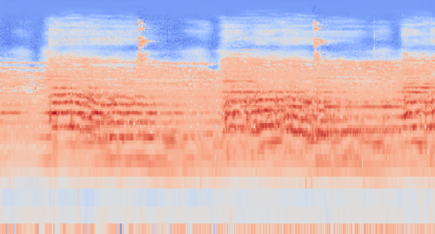

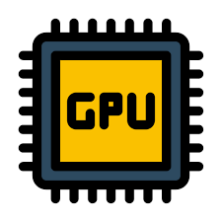

Challenges
Representation
Dataset:
Spectrogram
Log Magnitude Spectrogram
Mel Spectrogram
Infinitely many segments
Versatile vocals & accompaniment
Computational Resources:
Evaluation:
Deep Network
Training custom model – no fine tuning
Limited GPU access
Lack of well-defined evaluation metrics

Slide 22
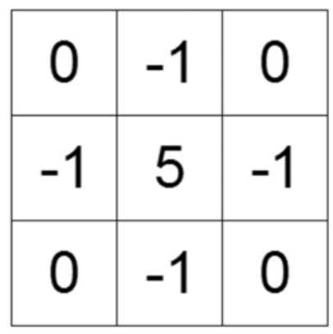

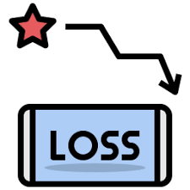

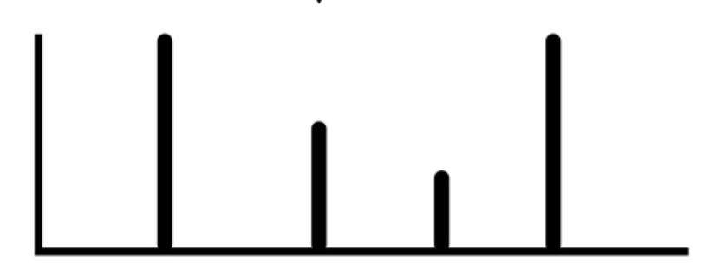
Additional Thoughts
Spectral – Temporal trade off: more frequency bins
Loss: SDR loss
Postprocessing: Use a sharpening kernel

Slide 23

Thanks for listening

